Slide 1
Evolution
What is this?

Slide 2
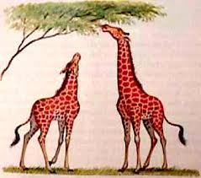
Giraffes

Slide 3
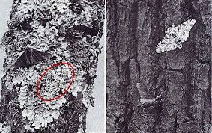
Moths

Slide 4
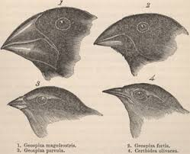
Biogeography
Biogeography is the study of the distribution of species and ecosystems in geographic space and through geological time. Organisms and biological communities vary in a highly regular fashion along geographic gradients of latitude, elevation, isolation and habitat area.

Slide 5
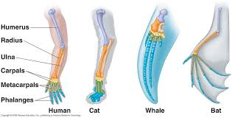
Homologies

Slide 6
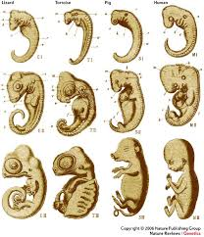
Embryology

