Slide 1
Cell Transport & Homeostasis Key Terms

Slide 2
Semi-permeable
Allowing certain substances to pass through
Cell membrane is semi-permeable, it allows certain substances to cross but not others
Notes:
Ask students to define each term before showing the formal definition. Discuss and expand upon the definition to help clarify students understanding.
You may wish to point out to students that “permeable” looks similar to the word “permissible” or “permission” and essentially means the same thing “permitting certain molecules to cross the cell membrane”.

Slide 3
Homeostasis
Regulation of an organism’s internal environment in order to maintain conditions suitable for survival
Happens on the organism and cellular level
Notes:
Ask students to define each term before showing the formal definition. Discuss and expand upon the definition to help clarify students understanding.
Inform students that the types of transport to follow are all ways that cells work to maintain homeostasis. Remember to stress this as you discuss each type of transport that follows.

Slide 4
Passive Transport
Movement of substances across the cell membrane that does not require energy from the cell (high concentration to low concentration)
Diffusion, Facilitated Diffusion and Osmosis are three examples.
Notes:
Ask students to define each term before showing the formal definition. Discuss and expand upon the definition to help clarify students understanding.

Slide 5
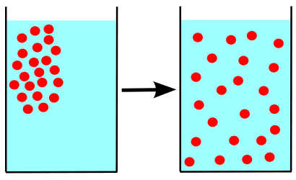
Diffusion
Movement of particles from an area of higher concentration to an area of lower concentration
Type of passive transport
Notes:
Ask students to define each term before showing the formal definition. Discuss and expand upon the definition to help clarify students understanding.
**Consider showing online simulations of diffusion if students need more visual aides to understand this concept.**
Graphic: http://commons.wikimedia.org/wiki/File%3ADiffusion.svg, By JrPol (Own work) [GFDL (http://www.gnu.org/copyleft/fdl.html) or CC-BY-3.0 (http://creativecommons.org/licenses/by/3.0)], via Wikimedia Commons

Slide 6
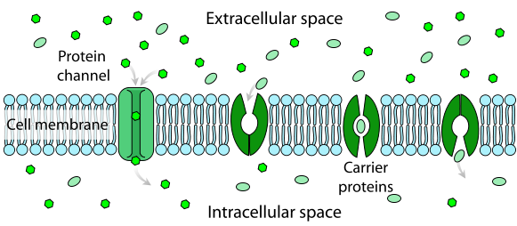
Facilitated Diffusion
Substances cross the cell membrane with the help of special carrier proteins
Type of passive transport
Notes:
Ask students to define each term before showing the formal definition. Discuss and expand upon the definition to help clarify students understanding.
Consider showing an animation such as this one if time allows: http://highered.mcgraw-hill.com/sites/0072495855/student_view0/chapter2/animation__how_facilitated_diffusion_works.html
Graphic: http://commons.wikimedia.org/wiki/File%3AScheme_facilitated_diffusion_in_cell_membrane-en.svg, By LadyofHats Mariana Ruiz Villarreal [Public domain], via Wikimedia Commons

Slide 7
Osmosis
Diffusion of water from an area of higher concentration to an area of lower concentration
Notes:
Ask students to define each term before showing the formal definition. Discuss and expand upon the definition to help clarify students understanding.
Briefly review lab experiences (eggs, Elodea leaves) again with students. Consider showing an animation if students need reinforcement of this concept.

Slide 8
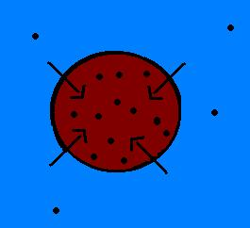
Hypotonic Solution
A solution or environment surrounding a cell that has less dissolved solutes and more water than the cell
This type of solution will cause water to move into the cell via osmosis, resulting in swelling of the cell
Notes:
Ask students to define each term before showing the formal definition. Discuss and expand upon the definition to help clarify students understanding.
**Explain to students that in animal cells, the cell will eventually burst due to too much pressure; in plant cells, the cell becomes rigid and helps the plant maintain its shape.**
Graphic: http://commons.wikimedia.org/wiki/File%3AHypotonic.jpg, By Sascheme at en.wikibooks [Public domain], from Wikimedia Commons

Slide 9
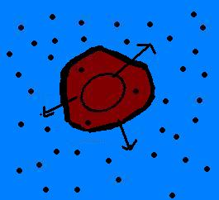
Hypertonic Solution
A solution or environment surrounding a cell that has more dissolved solutes and less water than the cell
This type of solution will cause water to move out of the cell via osmosis, resulting in shrinking of the cell.
Notes:
Ask students to define each term before showing the formal definition. Discuss and expand upon the definition to help clarify students understanding.
Graphic: http://commons.wikimedia.org/wiki/File%3AHypertonic.jpg, By Sascheme at en.wikibooks [Public domain], from Wikimedia Commons

Slide 10
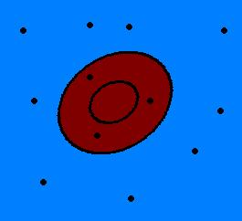
Isotonic
A solution or environment surrounding a cell that has the same amount of dissolved solutes and the same amount of water as the cell
Notes:
Ask students to define each term before showing the formal definition. Discuss and expand upon the definition to help clarify students understanding.
**Explain to students that there is still movement of solutes and water across the cell membrane, but the movement causes no net change (equilibrium)
Graphic: http://commons.wikimedia.org/wiki/File%3AIsotonic.JPG, By Sascheme at en.wikibooks [Public domain], from Wikimedia Commons

Slide 11
Active Transport
Movement of particles across a membrane to an area of higher concentration, which requires energy
Notes:
Ask students to define each term before showing the formal definition. Discuss and expand upon the definition to help clarify students understanding.
**Have students relate this to when they are “active” vs. when they are “passive”; to do activities and be active, they must exert energy.

Slide 12
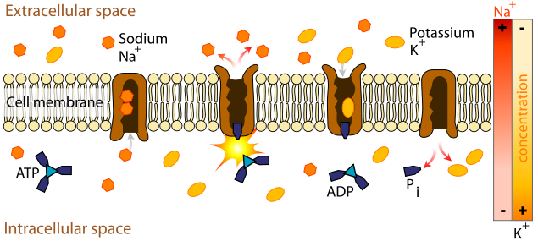
Ion or Protein Pump
Proteins that are able to transport ions across the cell membrane from low to high concentration by changing their shape which requires ATP (energy) from the cell
Example: sodium-potassium pump (important in nerve responses)
Notes:
Ask students to define each term before showing the formal definition. Discuss and expand upon the definition to help clarify students understanding.
Graphic: http://commons.wikimedia.org/wiki/File%3AScheme_sodium-potassium_pump-en.svg, By LadyofHats Mariana Ruiz Villarreal [Public domain], via Wikimedia Commons

Slide 13
Endocytosis
Cell brings in a bulky substance from its surroundings by wrapping its membrane around the substance and forming a vesicle
Ex: White blood cells “eat” bacteria using this process.
Notes:
Ask students to define each term before showing the formal definition. Discuss and expand upon the definition to help clarify students understanding.
You may wish to expose students to the two types of endocytosis: phagocytosis (“cell eating”) and pinocytosis (“cell drinking”)

Slide 14
Exocytosis
Cell releases substances by merging a vesicle with the cell membrane and releasing the substances into the fluid around the cell
Ex: cell releases waste products
Notes:
Ask students to define each term before showing the formal definition. Discuss and expand upon the definition to help clarify students understanding.

